Slide 1

What do students need from you?
Victoria Clout
(School of Accounting)
Natalie Oh
(School of Banking & Finance)

Slide 2

Schedule of presentation
3:00 PM – 3:05 PM
Welcome
3:05 PM – 3:30 PM
Talking about student feedback from T1 (Victoria)
3:30 PM – 3:50 PM
Talking about tutor & PASS feedback from T1 (Natalie)
3:50 PM – 4:00 PM
Questions & Answers from the audience

Slide 3

Talking about student feedback from T1 (Victoria)
What do students like in online teaching
What do student not like in online teaching
Overall statistics of T1 experience of online (distance learning)

Slide 4


Undergrad - Overall:
Liked best:
Greatest concerns:

Slide 5

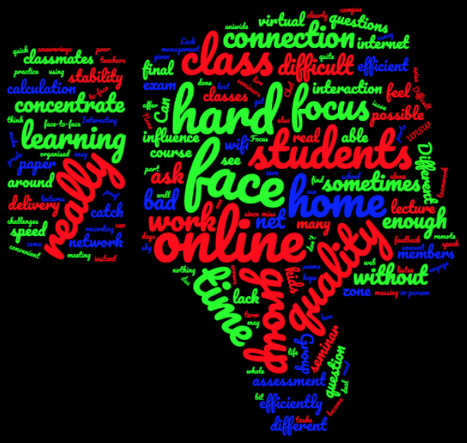
Postgrad - Overall:
Greatest concerns:
Liked best:

Slide 6


Local students

Slide 7
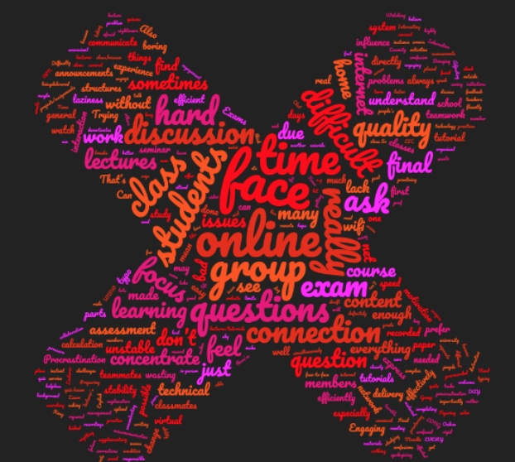

International students

Slide 8
What postgrad students like:
Less hands up to test if we can hear or see
More microphone use by fellow students
More interactive activities/engagement
More polls to check if we familiar with the content and then decide to put more or less time into explaining that topic
More polls for challenging areas to find out where we are going wrong
More recordings for catching up on missed classes particularly due to internet issues
More student engagement
More videos
More encouragement by teaching staff to direct students to use their webcams and microphones

Slide 9
What undergrad students like:
Less use of the chat option
More direct questioning to prevent the same students from answering every question
More student interaction with each other
More discussion time with students in the chat
More MCQ polling to focus and engage
More see each other and see other group’s discussions
More interactive activities
A deeper explanation of concepts
More polls
More opportunities to ask questions
More teamwork in class
More other students turning on their microphone and webcam during class to see each other

Slide 10
Breakout groups - positives
Brainstorming
Smaller group sizes
Groups help each other
Interactive
Lecturer can discuss with groups by visiting
More access to the tutor when they visit the breakout group as the group is smaller than the main tutorial size
Easier to talk to each other
No distractions, can concentrate on talking to each other

Slide 11
Breakout groups - negatives
Shy online students don’t want to discuss, don’t turn on microphone or webcam
Need to use apps outside the online class to finish group work
Lecturer takes too much time to form breakout groups (in Collaborate Ultra)
Nobody wants to talk
Less engaging than in person
Can’t go back to the main room while in breakout rooms
Can’t see the question/don’t know what to do
Online tutorial attendance was low so many group mates missing

Slide 12
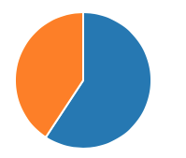
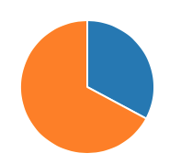
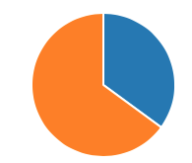




Incoming Term 2 ACCT1511 students pre-polling (41% response rate)
NO
YES
YES
59%
YES
35%
NO
NO
32%
41%
65%
68%
Class contribution e.g.
Individual quizzes in class
Team contribution e.g.
Team quizzes in class
Discussion Board
Participation activity

Slide 13
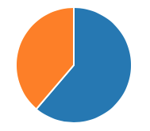
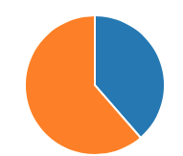
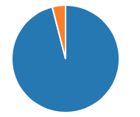


Student polling questions:
NO
4%
NO
YES
YES
40%
YES
NO
40%
96%
60%
60%
Student developed quiz questions
If the Lectures are live streamed at the timetabled slots would you be interested to attend?
Self-check quizzes
On the Moodle site
Completion not correctness

Slide 14
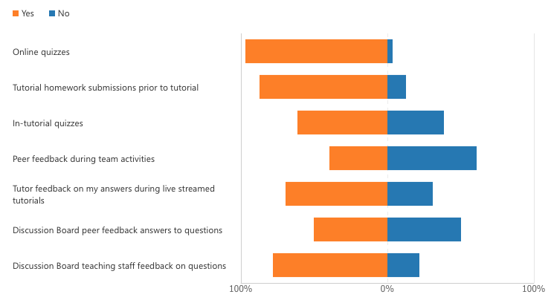
What types of feedback should we provide in an online format to to help you improve?
YES
NO
YES
NO
YES
NO
YES
NO
YES
NO
YES
NO
YES
NO

Slide 15
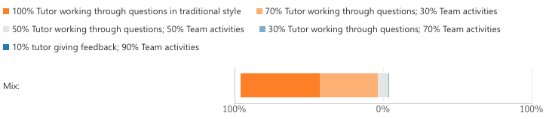
What is the mix of activities would you most prefer during live streamed tutorials?

Slide 16
What do students like in online teaching
They like interactive classes
Using chat/polls
Seeing other students
Interacting with out students

Slide 17
What do student not like in online teaching
Lack of engagement from their fellow students
Feeling left out of the conversation
Other students dominating the discussion
Unknown of online assessments, particularly online exams
Uncomfortable using microphone during class
Technical issues with internet connections and dropping out

Slide 18


Course feedback from T1 ACCT1511
What were the most challenging elements of studying online?
What have been the best elements of studying online?:

Slide 19


My teaching feedback T1 ACCT1511
The best features of Victoria Clout's teaching were
Victoria Clout’s teaching could be improved by:

Slide 20







MyExperience- Student Feedback Surveys
Guidance for Students on giving feedback
We have all been trying to figure out online teaching during COVID-19
Don’t forget your teaching staff Professors/Tutors are human beings – words can and do hurt
If something wasn’t great – how could it be better?
Please share your feedback via the MyExperience or if you want send an email during Term
If someone or a program really helped you – they’d love to hear it

Slide 21
Setting boundaries with students
Have an email policy – put this on the Moodle site and self-enforce it. For example “emails are replied to Monday-Friday 9am-5pm, outside this time emails will be replied to the following day. Please do not send the same email multiple times”.
Have a discussion board policy – when it will close down. For example at 5pm the day before the exam staff will stop responding to emails. This way students will get a good night’s rest (and so will you!)
Have a class policy – “we can be informal but must be respectful”.

Slide 22

Summary:
Live lectures with an opportunity to ask questions
More interaction during class
Regularly ask for feedback from students, e.g. have an Exit Survey
Go old style and call students by name to participate
Mix up your use of interactive tools, e.g. polls, microphone, etc.
Be aware of students’ preference for live interaction
Students prefer lecture recordings over short videos

