Slide 1
Name of Tutorial/Class/
Lecture
Insert Image of your Choice
Insert here
Name and Details of Lecturer

Slide 2

Hello my name is ……..

Slide 3
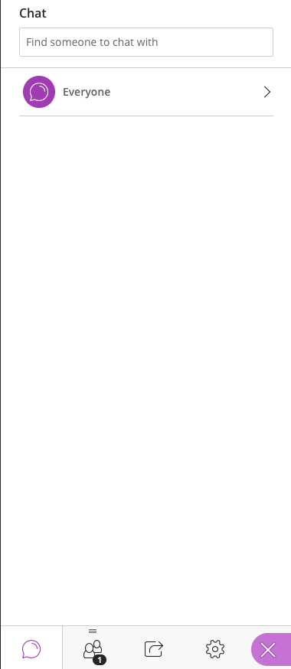
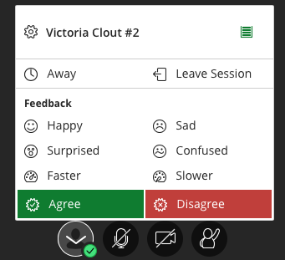


Welcome to Collaborate Ultra • Quick Guide
Test these controls while we wait for everyone to arrive…
You can choose to turn off your video if you don’t want it on all the time, but when speaking it helps to make you more ‘present’!
Click on this purple tab on the right-hand corner to open the Chat Text section.
In the Chat Text section you can type a question to the whole class or just your instructor using the ‘Find someone’ box.
If you want to indicate your reaction – e.g. agree or disagree. Click on the person icon and then click ‘agree’ or ‘disagree’
If your instructor asks you to share content to the whole class or a break-out group you can do so by be able to do by clicking on this icon below.
Please turn your mic off when not speaking, to minimize background noise
Click on the raise hand button if you want to ask a question.
To adjust volume or camera click here.

Slide 4
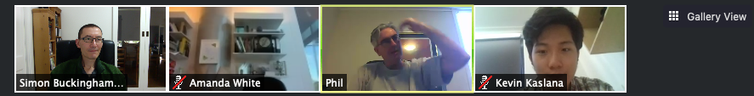
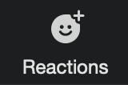

Welcome to Zoom • Quick Guide
Test these controls while we wait for everyone to arrive…
You can choose to turn off your video if you don’t want it on all the time, but when speaking it helps to make you more ‘present’!
Share a specific window (or on your device with the room. Everyone can see what you do in that window
(e.g. moving your mouse, using menus, editing, etc.)
Click this to view everybody’s image
(only visible if no screen is being shared)
Please turn your mic off when not speaking, to minimize background noise
Open/Hide the text chat window to share messages/links with everyone, or specific people
Click here for options – you can wave, thumbs up and raise your hand

Slide 5

















Live Stream – Lectures/Tutorials/Class Netiquette
Hello
Mute your microphone when not speaking
Say Hi when you arrive in the chat-box
Turn your webcam on when speaking
Use the raise hand button when you have a question or wish to talk
Use the chat-box feature to ask or answer a question
Be on
Time, be prepared!
Use earphones with a microphone to reduce background noise
Wear what you would for class.
Remove or silence distractions
Sit in a well-lit space and mindful of your background.
Remember some classes are being video recorded
Make room for everyone to have a chance to speak
Use the same professional language you would in a F2F class
Remember some classes are being video recorded
All students must adhere to UNSW’s Student Code
Be patient, be kind, be respectful

Slide 6
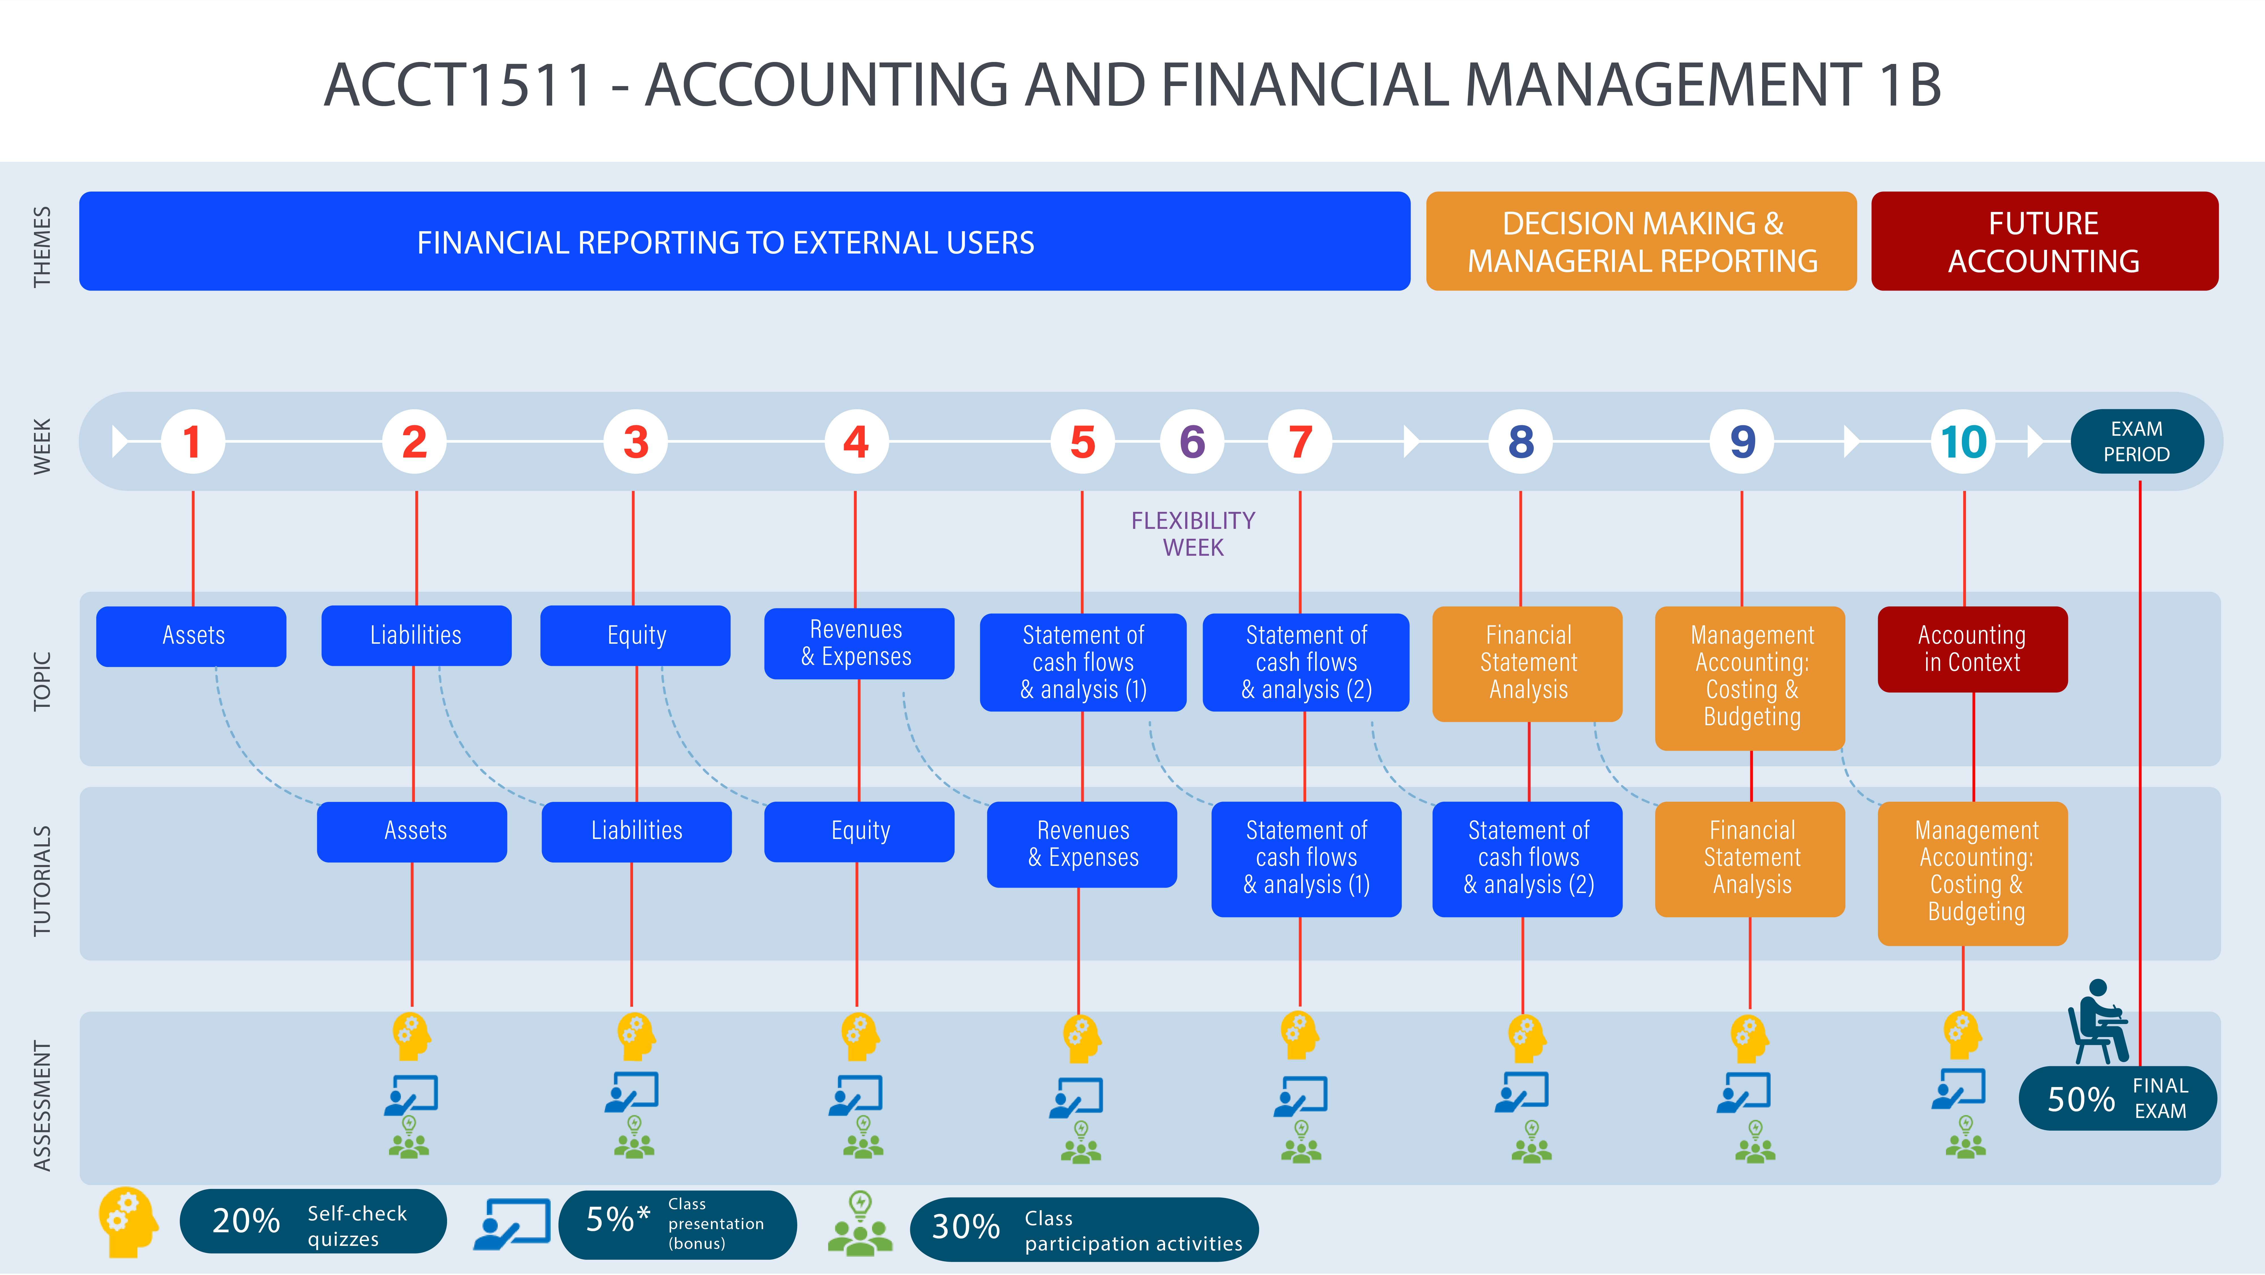
Course/Subject Outline Infograph - Example

Slide 7
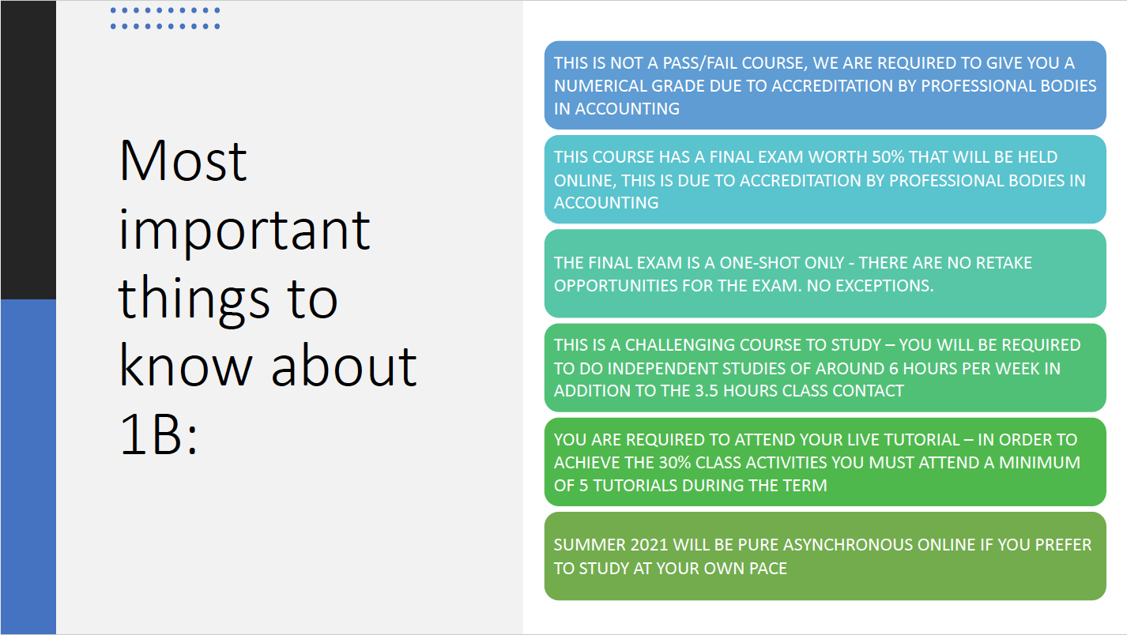
Important Notes about the Course/Subject - Example

Slide 8
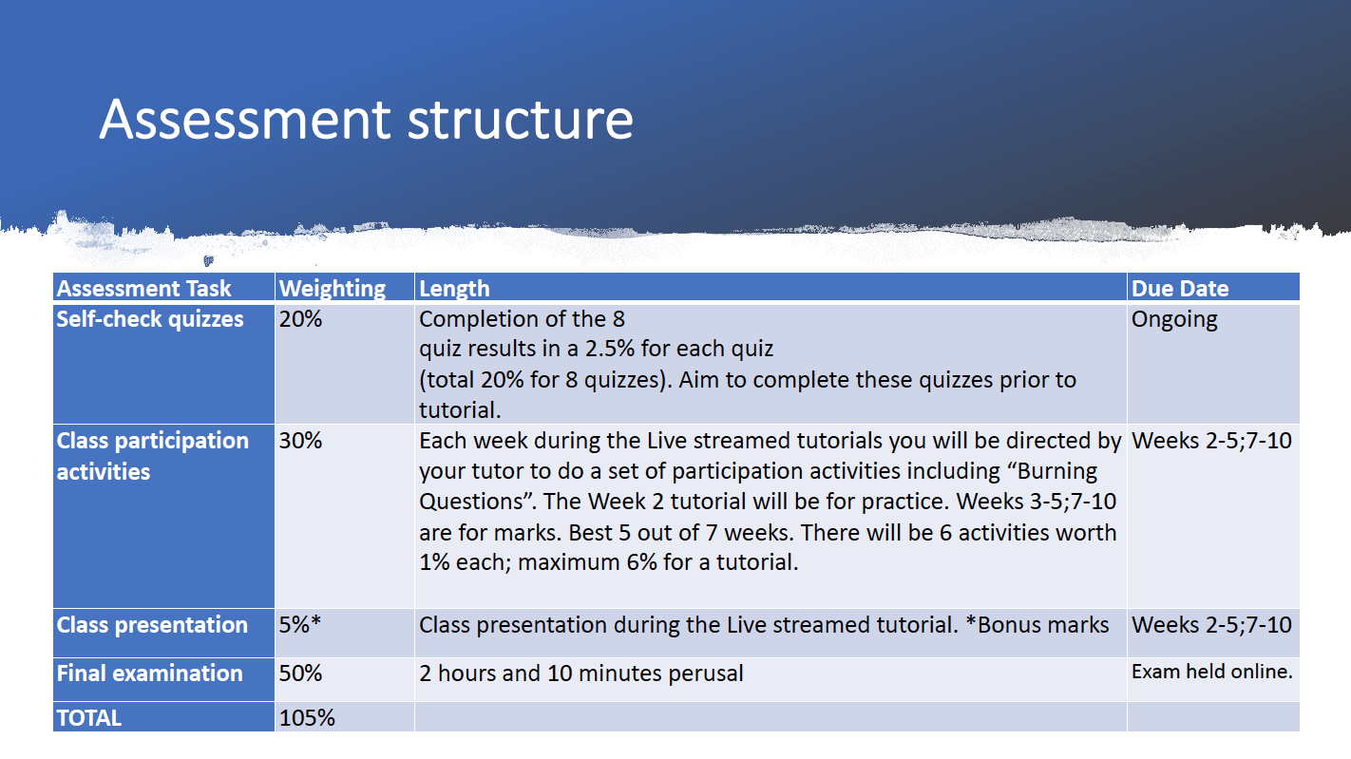
Assessment structure of the Course/Subject - Example

Slide 9
Class Participation Mark for the Course/Subject - Example
Class Participation (30%)
The amount of learning that takes place in this course critically depends on class interaction during tutorials. To encourage effective interaction, you will be awarded a combined mark for your participation in tutorials comprised of:
CLASS PARTICIPATION = INTERACTION X 6 CLASS QUIZ QUESTIONS CORRECT
Calculation of Class Participation Mark
The tutor will activate the quiz with 6 questions at the end of each tutorial. There will be 15 minutes timer and you will be directed to complete the quiz via Socrative. The quiz questions will be multiplied by your tutorial interaction mark. For example, a student who interacted:
CLASS PARTICIPATION = 1 X (6 questions correct / 6 questions)
      = 6 out of 6 marks
An example of a student who did not participate:
      CLASS PARTICIPATION = 0 X (6 questions correct / 6 questions)
      = 0 / out of 6 marks

Slide 10
Any questions?

