Slide 1

Facilitating Synchronous Live Stream Classes
Dr Victoria Clout
School of Accounting
UNSW Sydney

Slide 2
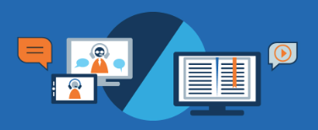
Asynchronous and synchronous work together!
Synchronous
(Live Class)
Asynchronous
(Moodle)

Slide 3
Synchronous Live Stream Classes
This session will cover:
What room should we use? Lecture/Tutorial/Seminar
Structure of the class
Time Considerations
Stimulating engagement

Slide 4

What platform is best to deliver the class?
& how much will you use of that tool?

Slide 5
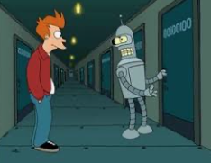

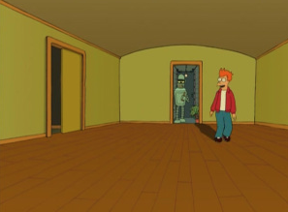
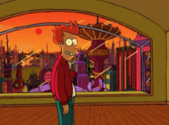
you might be using a pre-existing live class stream tool, however….
Also you can unlock extra features!
Don’t just use the doorway!

Slide 6



Let the type of class guide you to the tool

Slide 7

Open the doors 15 mins before for technology this allows for warm-ups
This Photo by Unknown Author is licensed under CC BY-SA-NC

Slide 8

Have a Welcome slide & this can show controls slide

Slide 9
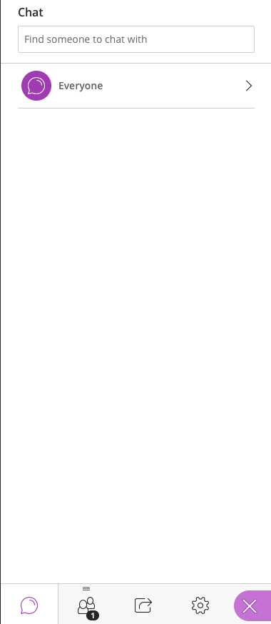
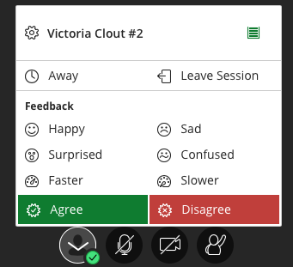


Welcome to ACCTXXX
Here are the Collaborate Ultra tools • Quick Guide
Test these controls while we wait for everyone to arrive…
Click on this purple tab on the right-hand corner to open the Chat Text section.
In the Chat Text section you can type a question to the whole class or just your instructor using the ‘Find someone’ box.
You can choose to turn off your video if you don’t want it on all the time, but when speaking it helps to make you more ‘present’!
If your instructor asks you to share content to the whole class or a break-out group you can do so by be able to do by clicking on this icon below.
If you want to indicate your reaction – e.g. agree or disagree. Click on the person icon and then click ‘agree’ or ‘disagree’
Please turn your mic off when not speaking, to minimize background noise
Click on the raise hand button if you want to ask a question.
To adjust volume or camera click here.

Slide 10
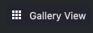
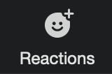

Welcome to ACCTXXX
Welcome to Zoom • Quick Guide
Test these controls while we wait for everyone to arrive…
Click this to view everybody’s image
(only visible if no screen is being shared)
You can choose to turn off your video if you don’t want it on all the time, but when speaking it helps to make you more ‘present’!
Share a specific window (or on your device with the room. Everyone can see what you do in that window
(e.g. moving your mouse, using menus, editing, etc.)
Open/Hide the text chat window to share messages/links with everyone, or specific people
Click here for options – you can wave, thumbs up and raise your hand
Please turn your mic off when not speaking, to minimize background noise

Slide 11
Welcome to ACCTXXX
here is a quick guide
to MS Teams Tools…

Slide 12









Live Stream – Netiquette (basic example)
Mute yourself
when not talking!
Be on
time!
Turn on video
if your internet is
strong enough.
Come
prepared!
Get comfy before
class starts.
Be respectful of
others
Find a quiet
place!
Click raise your
hand button to talk!
No eating, especially if the mic is on.

Slide 13

















Live Stream – Netiquette (more advanced example)
Sit in a well-lit space and mindful of your background.
Be on
Time, be prepared!
Use earphones with a microphone to reduce background noise
Wear what you would for class.
Remove or silence distractions
Hello
Mute your microphone when not speaking
Use the raise hand button when you have a question or wish to talk
Use the chat-box feature to ask or answer a question
Turn your webcam on/off as needed
Say Hi when you arrive
Make room for everyone to have a chance to speak
Use the same professional language you would in a F2F class
Remember some classes are being video recorded
All students must adhere to UNSW’s Student Code
Be patient, be kind, be respectful

Slide 14

Start off with an ice-breaker
Ask students to type their name, raise their hands

Slide 15

Provide a class schedule for students

Slide 16
Provide a time structure at the beginning of class
Here is an example for a 2 hour class:
Start | End | Min | Activity | Format
9:45AM | 10:00AM | 15 | Class door opens Chat introductions & login to the response system (e.g. GoogleDoc or Socrative or Echo360) | Plenary session
10:00AM | 10:20AM | 20 | Session begins Orientation of what to expect How to login to the response system | Plenary session
10:20AM | 10:35AM | 15 | Individual quiz | Individual quiz in Plenary session
10:35AM | 10:50AM | 15 | Instructions for teams Breakout into teams Team introductions Team quiz | Team quiz in virtual break-out room
BREAK |  | 5 | BREAK
10:55AM | 11:10AM | 15 | Clarifications / ”Burning Questions” | Plenary session
11:10AM | 11:30AM | 20 | Application or Short answer extended Team activity | Team application/activity in virtual break-out room
11:30AM | 11:50AM | 20 | Discussion/Gallery-Walk of answers | Plenary session
11:50AM | 12:00PM | 10 | Closing (Feedback survey / Team peer evaluation activity) | Plenary session
Adapted from: https://www.intedashboard.com/

Slide 17
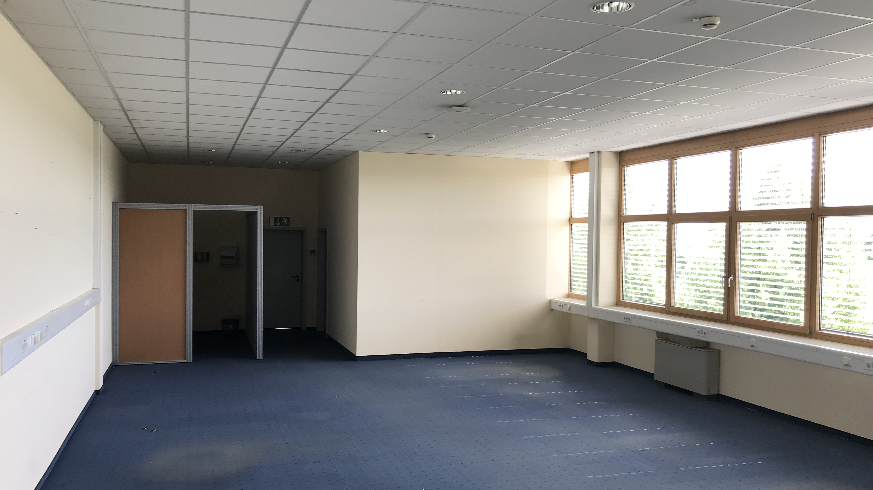

ENAGEMENT…
Hello? Is anybody there?

Slide 18


Think of ways to stimulate engagement
It is easy to become a ghost in the online world.
If there is no way to engage students might be tempted to Netflix and not come back
Ask students to give you feedback and also make some ‘pauses’ for them to think
Try to mix things up – e.g. poll, microphone, chat-type, long answer responses, post-it note walls - don’t get stuck in one way to communicate and engage

Slide 19
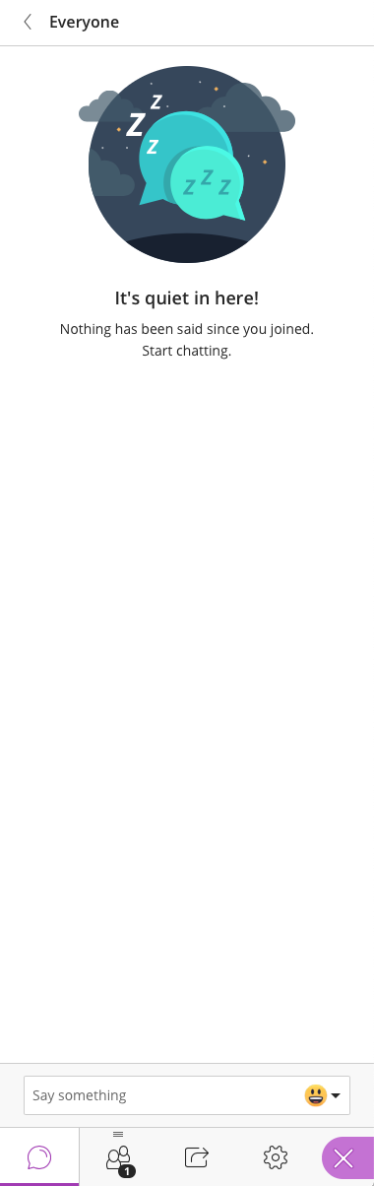
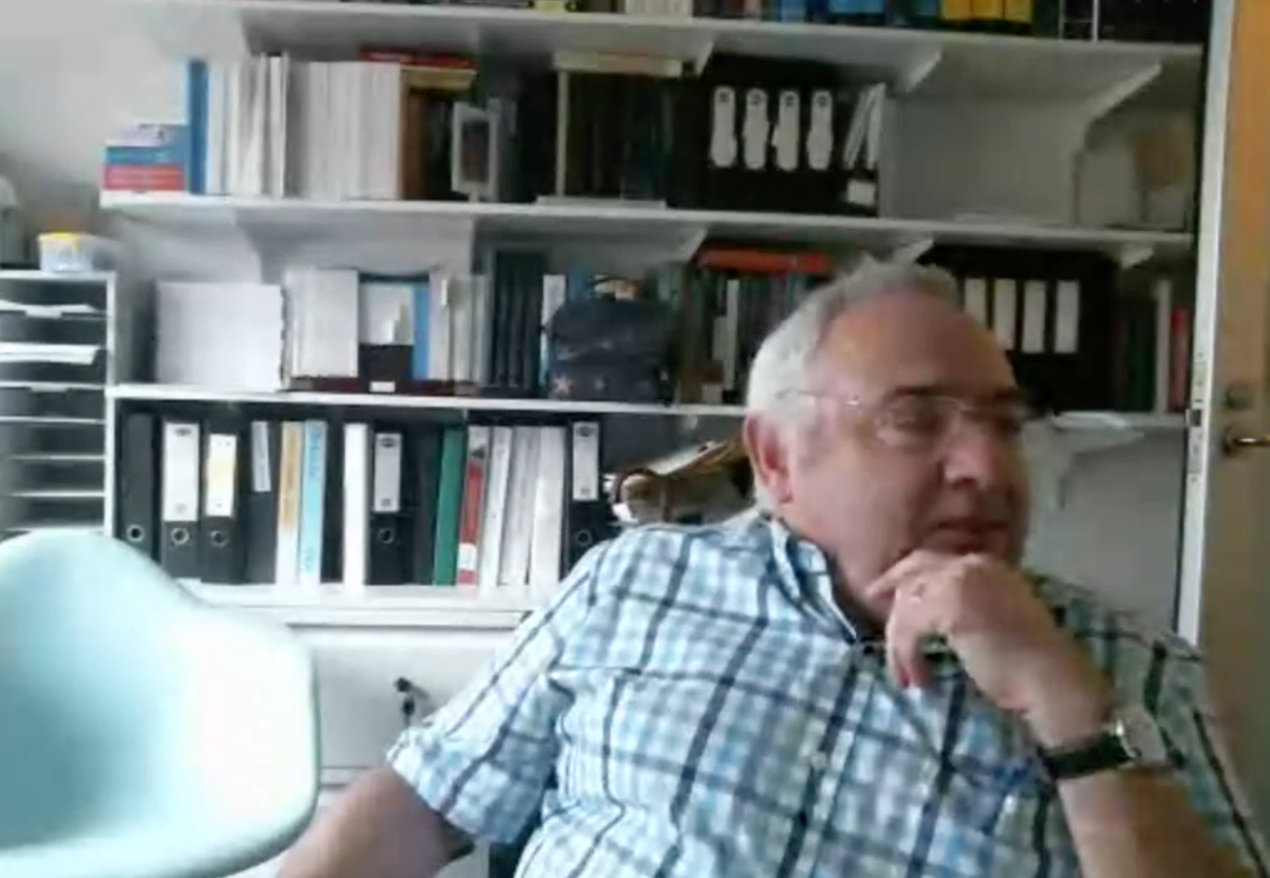
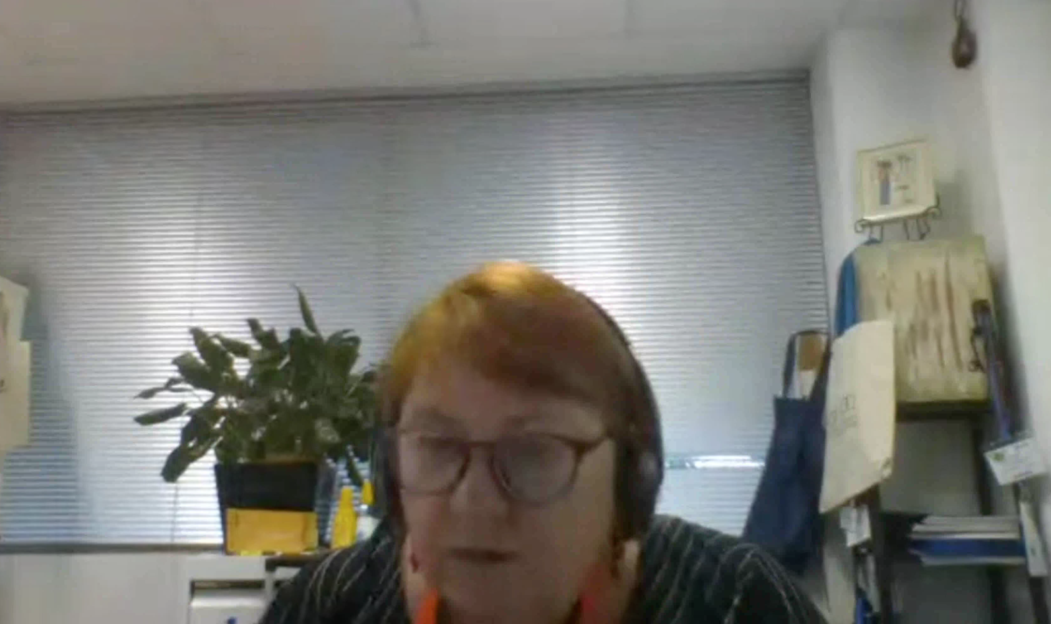
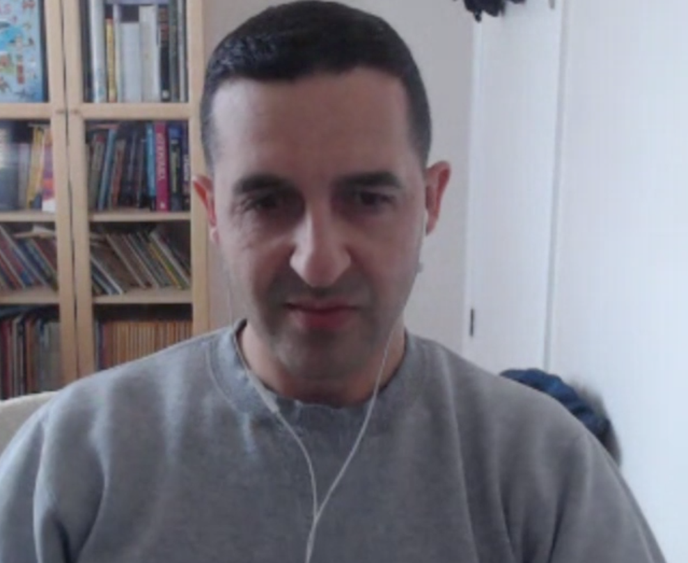


Slide 20
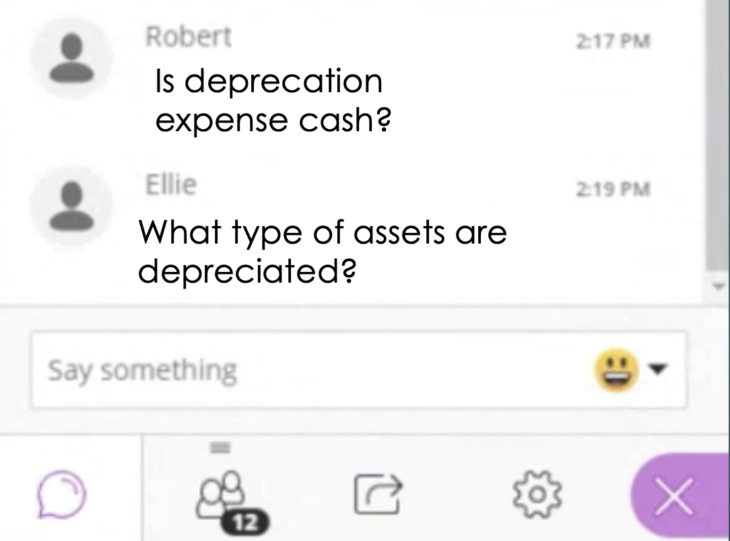
Chat-Box – ask students to type then the instructor should curate and moderate read out names

Slide 21

Hang on a minute…

Slide 22
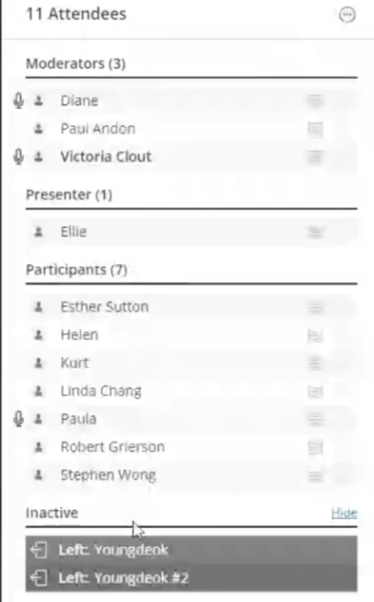
Read out student names – ask them ‘What do you think?’

Slide 23

Whiteboard Function
You can ask students to write as well
You can load up a pdf into Collaborate and draw on top
If you don’t like the in-built whiteboard you could use other tools like www.miro.com for shareable whiteboards

Slide 24

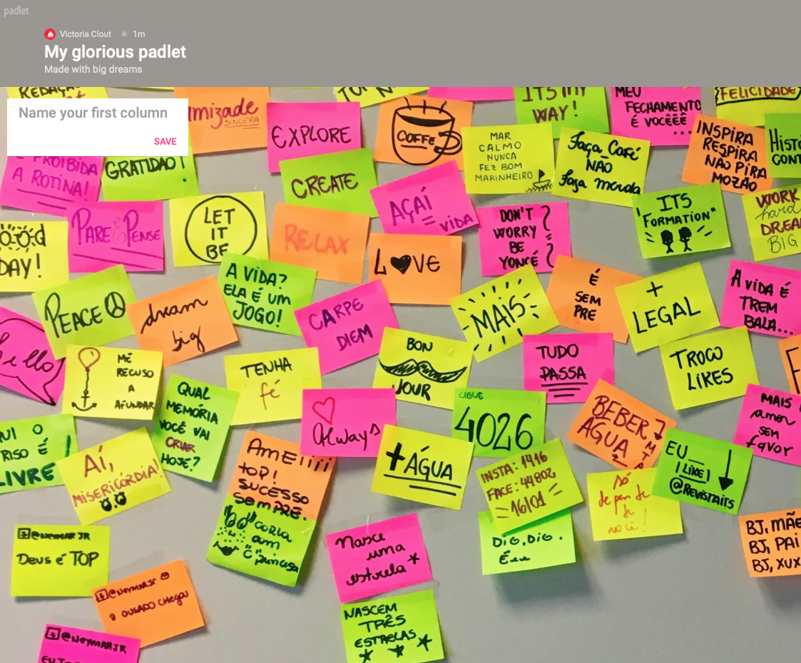
Padlet - post-it note wall approach
https://padlet.com/
3 Free walls… then you have to pay for more walls
See the real-time typing of answers
Headings for topics/questions/ideas

Slide 25

Instructor tips

Slide 26


For yourself - Test, test, test
Get comfortable with the tool you are using to teach the classes.
Go in the tool by yourself and see what all the buttons are
Do a practice where you go through the motions of a class, such as sharing your screen.
Ask a colleague/teaching team member to go in with you and talk through what your class will look like

Slide 27

What to do when it all goes wrong during a live class

Slide 28


Please STAND BY…
Have a game plan for the possibility of technology failure.
Explain to students calmly – talk through what the issue is, sometimes they can help you trouble-shoot the problem.
When in doubt try using GoogleChrome browser if you use another browser
Try going out and back in again to the tool.
Have back-up Google Sheets/Docs to share with links

Slide 29

Ask for help – reach out to the bdl team

Slide 30

Have a teaching team member standing by in the background

Slide 31

Use the resources available – school of accounting & Business School Microsoft teams site

Slide 32
Setting boundaries with students
Have an email policy – put this on the Moodle site and self-enforce it. For example “emails are replied to Monday-Friday 9am-5pm, outside this time emails will be replied to the following day. Please do not send the same email multiple times”.
Have a discussion board policy – when it will close down. For example at 5pm the day before the exam staff will stop responding to emails. This way students will get a good night’s rest (and so will you!)
Have a class policy – “we can be informal but must be respectful”.

Slide 33








MyExperience- Student Feedback Surveys
Guidance for Students on giving feedback
We have all been trying to figure out online teaching during COVID-19
Don’t forget your teaching staff Professors/Tutors are human beings – words can and do hurt
If something wasn’t great – how could it be better?
Please share your feedback via the MyExperience or if you want send an email during Term
If someone or a program really helped you – they’d love to hear it

Slide 34
Any questions?

