Slide 1
Facilitating Asynchronous Online Environments
Dr Victoria Clout
School of Accounting
UNSW

Slide 2
More presentations coming up…
Date/time | Presenter/ Facilitator | Topic | Registration Link
20 May 2-3pm | Victoria Clout | Making teamwork ‘work’ in online classes | link
27 May 3-4pm | Victoria Clout & Natalie Oh | Learning from T1 – What do Students Need from You? | link

Slide 3
Asynchronous learning
Students are learning at different times
Communication for this component is not live
Can be convenient and flexible for students to access
Allows students to work at their own pace
Vs - Synchronous learning – all students learning at the same time (e.g. live streamed lecture/tutorial)

Slide 4
Asynchronous and synchronous can work together
Synchronous
(Live Class)
Asynchronous
(Moodle)

Slide 5
This is what you are starting with. Think about the set up of the learning environment (e.g. Moodle)
Moodle site

Slide 6
This looks better! You can add components to your moodle site & then develop your a strategy for ineracting through them

Slide 7
Be careful ! Not too much!

Slide 8
Asynchronous elements
Let’s build some

Slide 9
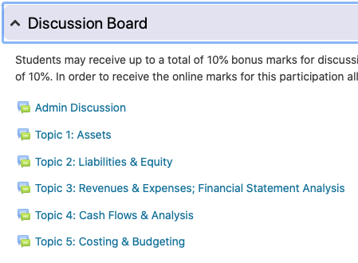
(1) Discussion boards
Discussion Board Rules: Keep the discussion relevant to this course; Be considerate to other students posting. Any posts that do not follow these rules will be deleted.
Students – welcome to the discussion board! Post your questions here. If you know the answer then please reply to help out your peers!
Students may receive up to a total of 10% bonus marks for discussion board posts. Where each constructive post is made, either a question or an answer to a previously posted question, will be awarded a 1%, up to a total of 10%. In order to receive the online marks for this participation all discussion board posts must be made no later than 7 February 5pm.

Slide 10
(2) Videos - but this could be more interactive!

Slide 11
(2) Video plus! Asynchronous elements!
VIDEO
Choice
Quiz
Discussion Forum with a leading question
Student created quiz

Slide 12
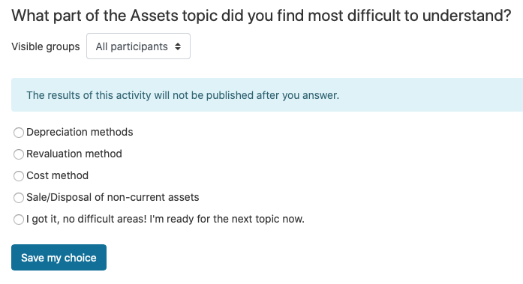
(3) choice
Displayed on the Moodle site
When a student clicks on the link it shows:
You will be able to see the Responses by clicking on “View” responses later on.
This could then be discussed in the live stream class.

Slide 13
(4) Quizzes
A quiz can be added which asks questions related to a video.
Or a quiz for end of topic revisions.
The quiz results could be used to guide discussion during class.

Slide 14
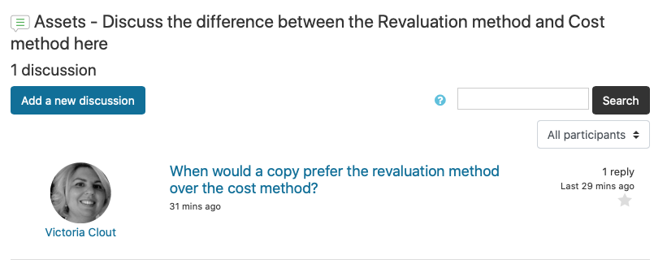
(5) Discussion forums with a leading question
Start things off with a question.
This could be based on a video or something that will be discussed in a synchronous class.
This could be just to start the discussion and then students will lead their own discussion as the Term progresses.

Slide 15
(6) Student built quiz questions

Slide 16
How you going now facilitate this asynchronous environment?

Slide 17
Regular communication on annoucements

Slide 18
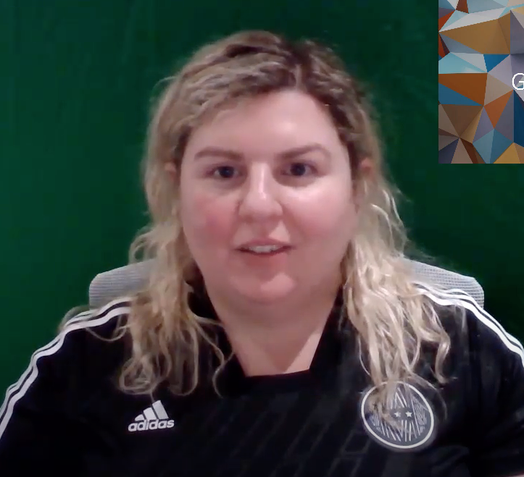
Video announcements or voice

Slide 19
Think about how you want to encourage students to interact together and participate during the term

Slide 20
Set some boundaries/expectations
You can tell students:
“On Wednesdays I have consultation and I’ll answer Discussion Board posts that day. If you can see a post that you would like to answer then please go ahead. I’m keen to see your ideas!”

Slide 21
Thanks for listening! Any questions?

Slide 22
Wait there is more…
More presentations coming up…
Date/time | Presenter/ Facilitator | Topic | Registration Link
20 May 2-3pm | Victoria Clout | Making teamwork ‘work’ in online classes | link
27 May 3-4pm | Victoria Clout & Natalie Oh | Learning from T1 – What do Students Need from You? | link

