Slide 1
Facilitating Asynchronous Learning Environments & Synchronous Live Classes
Dr Victoria Clout
School of Accounting
UNSW Sydney

Slide 2
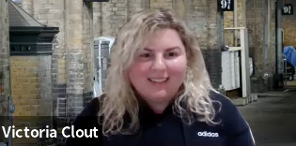
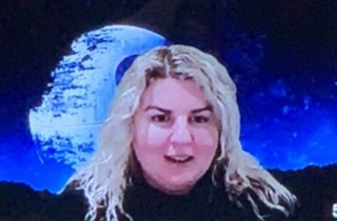
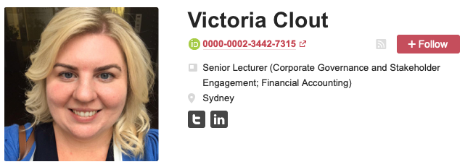
About Dr Victoria Clout:
A Senior Lecturer at UNSW Sydney. Victoria does high quality research projects within the areas of corporate governance, financial accounting and corporate finance. Victoria's research has relevance to the accounting industry, market regulators and investors. Victoria is a PhD qualified academic, with analytical skills, a track record in high quality research design, accounting knowledge, and experience in active learning and online teaching.
Find out more about Victoria…
Youtube videos: www.youtube.com/VictoriaClout
LinkedIn: https://www.linkedin.com/in/victoria-clout-2b97031a/
Twitter: https://twitter.com/DrVictoriaClout
Blog: https://drvclout.blogspot.com
Teaching Resources: https://figshare.com/authors/Victoria_Clout/8888411
Academic Humour Instagram: https://www.instagram.com/academichumour/
Victoria (& Amanda White’s) “I ❤️ Accounting Education” Microsoft Team (join 77 Academics from around the world)
Victoria also runs the social media accounts for the following journals:
Australian Journal of Management
Accounting & Finance
Editorial Boards: Accounting & Finance; Accounting Research Journal

Slide 3
Roadmap for navigating the online world of teaching
This presentation will cover:
Digital platforms for delivery & assessment
Creating stimulating asynchronous components
How to structure an online class
Time considerations
Effective use of break-out rooms
Techniques for stimulating student engagement
Guidance on setting expectations including Netiquette in online classes and spaces & Communication in the online world

Slide 4
What do students like & not like about online learning?

Slide 5
What do students like in online teaching
They like interactive classes
Using chat/polls
Seeing other students
Interacting with out students

Slide 6
What do student not like in online teaching
Lack of engagement from their fellow students
Feeling left out of the conversation
Other students dominating the discussion
Unknown of online assessments, particularly online exams
Uncomfortable using microphone during class
Technical issues with internet connections and dropping out

Slide 7
Rethinking assessment in the online world

Slide 8
A Guide to Online World of Assessment Items
Assessment Item
Method of delivery
Technology
Suggestion
Assessment Item
Technology
Suggestion
Method of delivery
Participation during a Live Streamed class – either by Chat/Voice
Collaborate Ultra or Zoom
Students video themselves given their presentation & submit the file or link
Moodle or MS Teams or Youtube link
Tutorial Participation
Tutorial Presentations
Online Discussion Board Posts – Give a criteria for good posts
Moodle or MS Teams
Delivered during the Collaborate Ultra/Zoom Class
Collaborate Ultra or Zoom
Students create & share their notes/resources for the topic
Moodle or MS Teams
Student led tutorial discussion in the Live Streamed class
Collaborate Ultra or Zoom
Students are asked some short answer or MCQ questions during the Live streamed tutorial
Moodle or Echo360 or Socrative
In Class Quizzes
Have a timed quiz, that opens and closes at a particular day/time
Moodle or MS Teams
Students submit their Homework online before the class
Moodle or MS Teams
Homework check
Have a quiz that is for participation only, low stakes, multiple attempts
Moodle or MS Teams
Students share to the whole class their tutor their work a Live Streamed class
Collaborate Ultra or Zoom
Students peer mark & review each others’ work in a ‘Gallery’ walk during class
Moodle or Echo360 or Socrative
Have students build their own quiz questions and have other students vote on their quiz questions.
Moodle or MS Teams
Run team or individual quizzes during or at the end of a Live Streamed class
Moodle or Echo360 or Socrative
Take-home exam
Moodle
Assignments
Final Exam
Submission online & graded by the instructor
Moodle or MS Teams
Timed Quiz – short answer & MCQ
Moodle
For core accredited courses: timed quiz with short answer & MCQ invigilated with ExamityAI
Moodle plus Socrative
Submission online, peer marked by another student & the instructor
Moodle or MS Teams

Slide 9
Creating stimulating asynchronous components

Slide 10
Asynchronous learning
Students are learning at different times
Communication for this component is not live
Can be convenient and flexible for students to access
Allows students to work at their own pace
Contrast to synchronous learning – all students learning at the same time (e.g. live streamed lecture/tutorial)
Synchronous
(Live Class)
Asynchronous
(Moodle)
Asynchronous and synchronous can work together

Slide 11
This is what you are starting with. Think about the set up of the learning environment (e.g. Moodle)
Moodle site

Slide 12
This looks better! You can add components to your moodle site & then develop your a strategy for ineracting through them

Slide 13
Be careful ! Not too much!

Slide 14
My recommended Moodle Asynchronous Tools for students
Course Self Completion
Completion Progress Bar
Calendar
Activities
Forums (Discussion Board)
Search Forums
Checklist

Slide 15
Thinking about platforms synchronous delivery

Slide 16
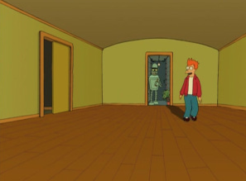
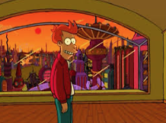
you might be using a pre-existing live class stream tool, however….
Also you can unlock extra features!
Don’t just use the doorway!

Slide 17
Let the type of class guide you to the tool

Slide 18
How to structure an online synchronous class

Slide 19
Online classes – Think about it like a rocket launch! t-20 to t+90 where t = tutorial start time (e.g. 9am)

Slide 20
T-20 mins – open up documents
T-15 mins – open up Collaborate Ultra & Roll on GoogleSheets
T-15 mins to T+5 lay out the welcome mat
T+5 mins to T+15 START - welcome plus introduction to the tutorial
T+15 mins to T+17 – Volunteers for presentation / you setup share screen
T+17 mins to T+65 mins - Main tutorial – cold calling/any presentations – polls/breakout groups if energy is low
T+65 mins – Direct students to open Socrative & start setting up the quiz – share your screen to show the room code
T+70 mins to T+85 Run the Class Activities MCQs via Socrative (if students finish early they can depart)
T+85 mins CLOSE – FINISH TUTORIAL
T+90 min done!

Slide 21
Open the doors 15 mins before for technology this allows for warm-ups
This Photo by Unknown Author is licensed under CC BY-SA-NC

Slide 22
Have a Welcome slide & this can show controls slide

Slide 23
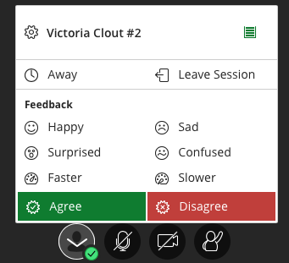
Welcome to ACCTXXX – my name is……
Here are the Collaborate Ultra tools • Quick Guide
Test these controls while we wait for everyone to arrive…
Click on this purple tab on the right-hand corner to open the Chat Text section.
In the Chat Text section you can type a question to the whole class or just your instructor using the ‘Find someone’ box.
You can choose to turn off your video if you don’t want it on all the time, but when speaking it helps to make you more ‘present’!
If your instructor asks you to share content to the whole class or a break-out group you can do so by be able to do by clicking on this icon below.
If you want to indicate your reaction – e.g. agree or disagree. Click on the person icon and then click ‘agree’ or ‘disagree’
Please turn your mic off when not speaking, to minimize background noise
Click on the raise hand button if you want to ask a question.
To adjust volume or camera click here.

Slide 24
Think about pilots in an airplane

Slide 25
Provide a time structure at the beginning of class Here is an example for a 2 hour class:
Start | End | Min | Activity | Format
9:45AM | 10:00AM | 15 | Class door opens Chat introductions & login to the response system (e.g. GoogleDoc or Socrative or Echo360) | Plenary session
10:00AM | 10:20AM | 20 | Session begins Orientation of what to expect How to login to the response system | Plenary session
10:20AM | 10:35AM | 15 | Individual quiz | Individual quiz in Plenary session
10:35AM | 10:50AM | 15 | Instructions for teams Breakout into teams Team introductions Team quiz | Team quiz in virtual break-out room
BREAK |  | 5 | BREAK
10:55AM | 11:10AM | 15 | Clarifications / ”Burning Questions” | Plenary session
11:10AM | 11:30AM | 20 | Application or Short answer extended Team activity | Team application/activity in virtual break-out room
11:30AM | 11:50AM | 20 | Discussion/Gallery-Walk of answers | Plenary session
11:50AM | 12:00PM | 10 | Closing (Feedback survey / Team peer evaluation activity) | Plenary session
Adapted from: https://www.intedashboard.com/

Slide 26
Techniques for stimulating student engagement

Slide 27
ENAGEMENT…
Hello? Is anybody there?

Slide 28
Think of ways to stimulate engagement
It is easy to become a ghost in the online world.
If there is no way to engage students might be tempted to Netflix and not come back
Ask students to give you feedback and also make some ‘pauses’ for them to think
Try to mix things up – e.g. poll, microphone, chat-type, long answer responses, post-it note walls - don’t get stuck in one way to communicate and engage

Slide 30
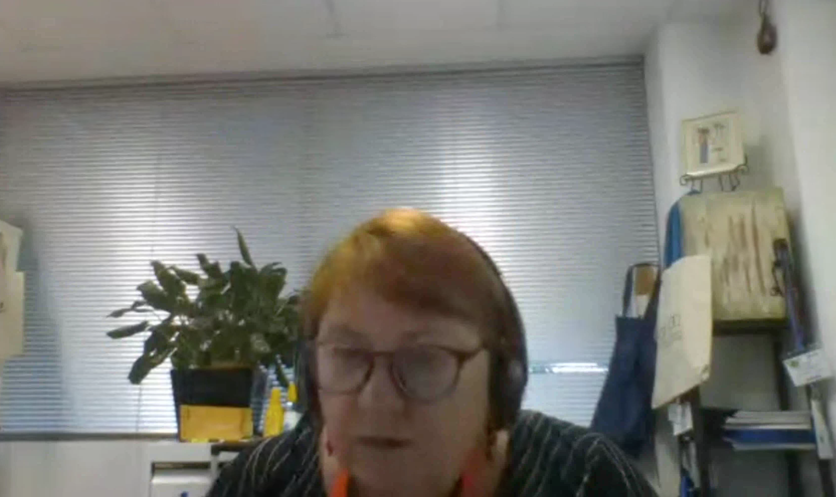
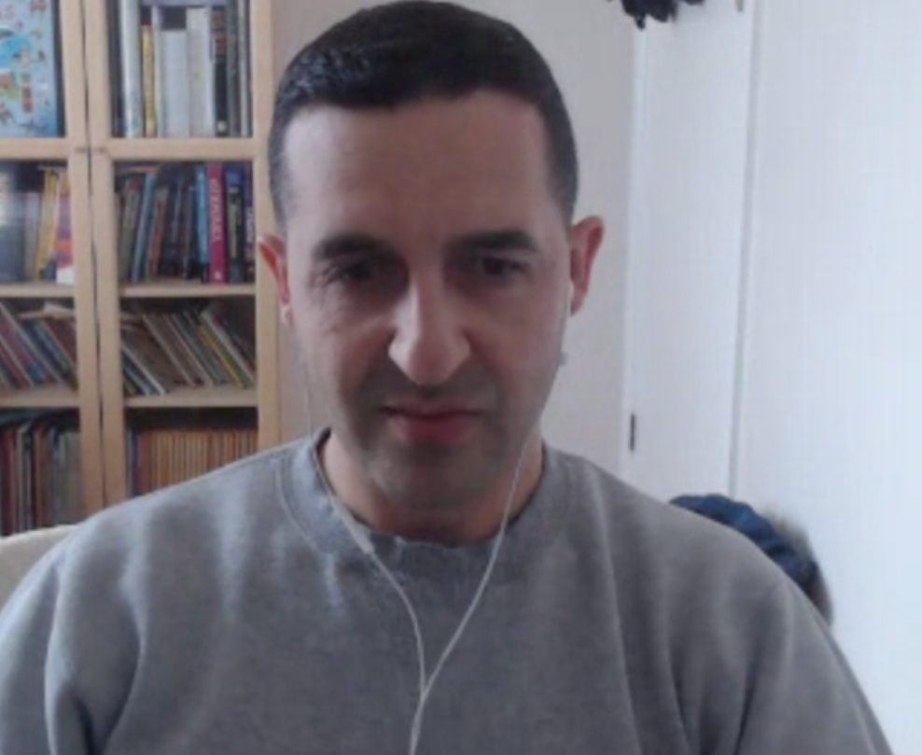

Slide 31
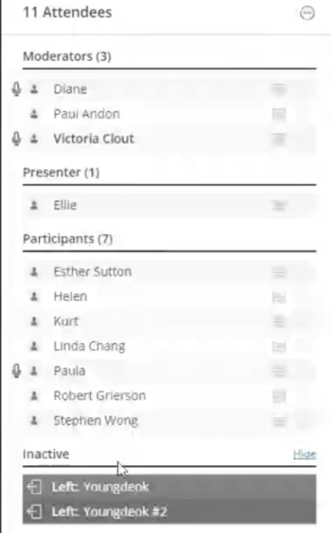
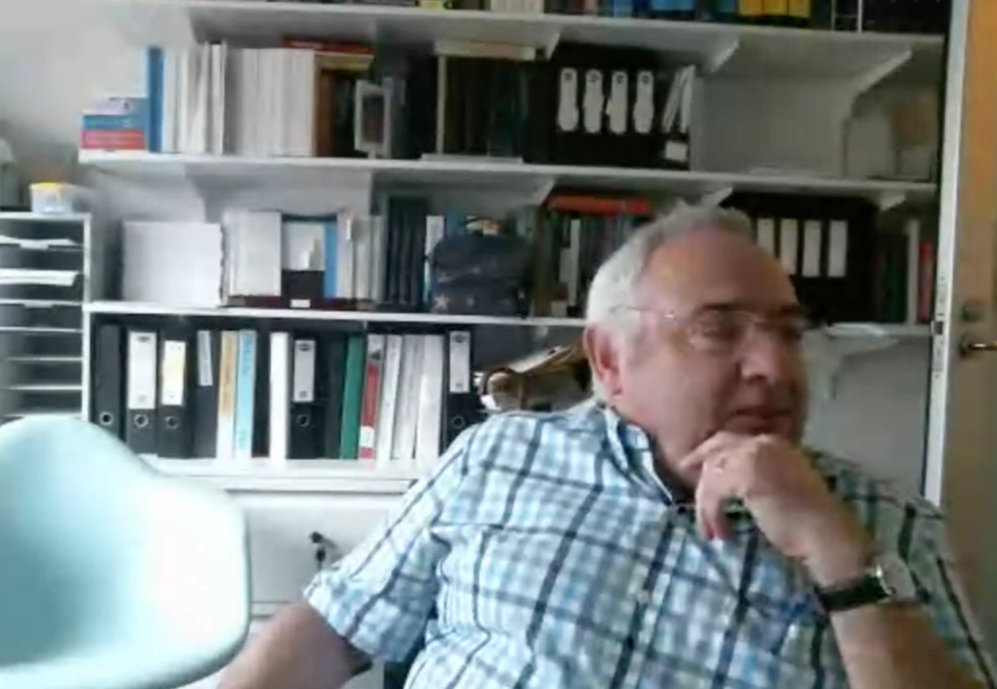
Student attendee list – helps you to
Cold-call students – ask their input

Slide 32
Chat-Box – ask students to type then the instructor should curate and moderate read out names

Slide 33
Hi Students, Welcome! I’m on my way from the previous tutorial. Please standby.

Slide 34
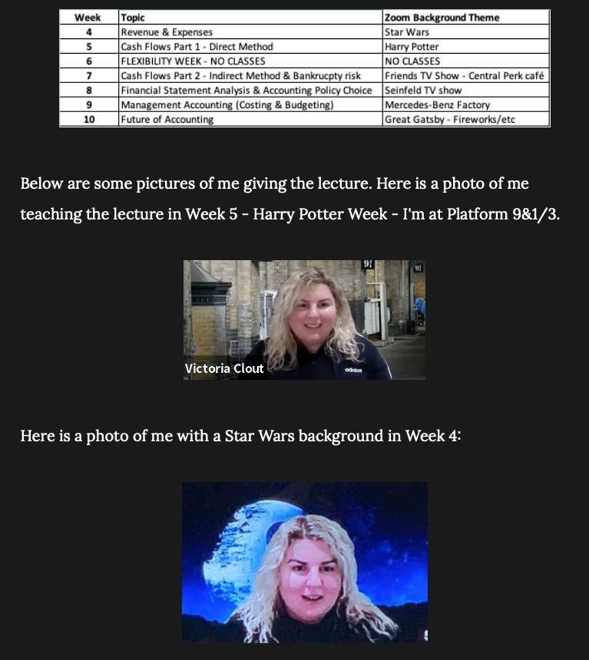
Be authentic Have fun!
For example Zoom backgrounds!

Slide 35
Effective use of break-out rooms

Slide 36
Breakout groups - positives
Brainstorming
Smaller group sizes
Groups help each other
Interactive
Lecturer can discuss with groups by visiting
More access to the tutor when they visit the breakout group as the group is smaller than the main tutorial size
Easier to talk to each other
No distractions, can concentrate on talking to each other

Slide 37
Breakout groups - negatives
Shy online students don’t want to discuss, don’t turn on microphone or webcam
Need to use apps outside the online class to finish group work
Lecturer takes too much time to form breakout groups (in Collaborate Ultra)
Nobody wants to talk
Less engaging than in person
Can’t go back to the main room while in breakout rooms
Can’t see the question/don’t know what to do
Online tutorial attendance was low so many group mates missing

Slide 38
Netiquette in online classes and spaces

Slide 39
Live Stream – Netiquette (basic example)
Mute yourself
when not talking!
Be on
time!
Turn on video
if your internet is
strong enough.
Come
prepared!
Get comfy before
class starts.
Be respectful of
others
Find a quiet
place!
Click raise your
hand button to talk!
No eating, especially if the mic is on.

Slide 40
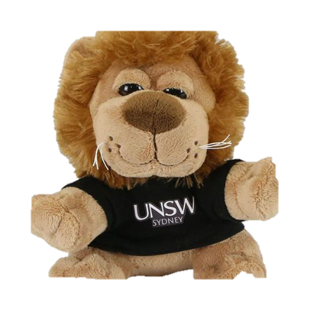
Live Stream – Netiquette (more advanced example)
Sit in a well-lit space and mindful of your background.
Be on
time, be prepared!
Use earphones with a microphone to reduce background noise
Wear what you would for class.
Remove or silence distractions
Hello
Mute your microphone when not speaking
Use the raise hand button when you have a question or wish to talk
Use the chat-box feature to ask or answer a question
Turn your webcam on/off as needed
Say Hi when you arrive
Make room for everyone to have a chance to speak
Use the same professional language you would in a F2F class
Remember some classes are being video recorded
All students must adhere to UNSW’s Student Code
Be patient, be kind, be respectful

Slide 41
Setting boundaries with students
Have an email policy – put this on the Moodle site and self-enforce it. For example “emails are replied to Monday-Friday 9am-5pm, outside this time emails will be replied to the following day. Please do not send the same email multiple times”.
Have a discussion board policy – when it will close down. For example at 5pm the day before the exam staff will stop responding to emails. This way students will get a good night’s rest (and so will you!)
Have a class policy – “we can be informal but must be respectful”.

Slide 42
MyExperience- Student Feedback Surveys
Guidance for Students on giving feedback
We have all been trying to figure out online teaching during COVID-19
Don’t forget your teaching staff Professors/Tutors are human beings – words can and do hurt
If something wasn’t great – how could it be better?
Please share your feedback via the MyExperience or if you want send an email during Term
If someone or a program really helped you – they’d love to hear it

Slide 43
Any questions?

Slide 44
THE END!
Get in touch with Dr Victoria Clout at:
v.clout@unsw.edu.au

