Slide 1
UNSW Active Learning Initiative:
Supporting academic staff in Active
Learning Spaces
Image goes here
Thursday 14 May 12.00 – 1.00pm

Slide 2
Agenda
What is the Active Learning Initiative?
How to make your virtual class ‘active’ using Blackboard Collaborate
Q & A Session
Active Learning Tools and Resources
Q & A Session

Slide 3
What is the Active Learning Initiative?
The Active Learning Initiative was established to address some of the challenges faced by academics in the use and adoption of active learning spaces available on UNSW’s Kensington campus. These include:
Awareness about the types of space available and how they can be accessed
Support with the effective use of the technology within these spaces
Lack of awareness on latest trends in teaching and learning and exemplars from within UNSW on effective active learning techniques in the classroom
Guides, examples, information, evidence and academic evaluations on how these spaces are improving learning outcomes, student satisfaction and the Scientia Educational experience
The Active Learning Initiative works with academics to support the adoption and practice of an active learning pedagogy by forming links and leveraging from other initiatives within the UNSW community like summative peer review, educational-focused positions, and academic development.

Slide 4
How to make your virtual class
‘active’ using
Blackboard Collaborate

Slide 5
How to make your virtual class active
Blackboard Collaborate Ultra tools available to help make your virtual class active
Discussion
Group Work
Multiple Choice
Brainstorm
PowerPoint
Share your computer screen

Slide 6
Using the Breakout Groups tool
Breakout Groups is a great tool to use for brainstorming, group work, problem solving or even parallel discussions in the virtual classroom
Example: You present a new topic for discussion in your lecture and ask your students to work together in groups to prepare a short speech outlining the key concepts of this topic. Each group will deliver their speech to the rest of the class
Another great way to have students present back to the rest of the class is to share their group’s presentation or findings using the Whiteboard tool when back in the Main Room
Students | Lecturer
Are able to access audio and video functions to chat including private video calling from the main group | Able to provide information and set guidelines for the activity including time limit as part of the lecture when in the Main Room
They can collaborate on their own whiteboard | Can switch among the different groups monitoring, listening, observing, asking questions and evaluating students’ understanding of concepts and tasks
Share files and content including media resources amongst themselves | Can gather information which is useful to share or expand on with the rest of the class such as summarising progress observed across the different breakout groups, clarifying any misconceptions or addressing frequently asked questions
Whilst their discussions are not able to be captured in the recording of the session, students are able to assign roles within their group such as scribe or spokesperson who will present back to the rest of the class | Able to evaluate the outcomes of the activity task set and ask students to do the same by reflecting and evaluating the outputs of their collaboration

Slide 7
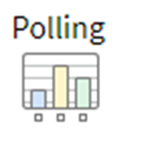
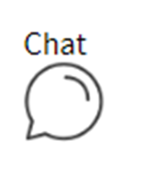
Blackboard Collaborate Ultra Tools
Tool | Purpose
 | Present real time information as you would writing on a whiteboard Students can contribute by using the text tool and write on a blank whiteboard Can be used in the same way you use a Document Camera Great for: Brainstorming Problem solving Group discussion
 | Choice of Multiple Choice or Yes/No Answers Responses are anonymous Great for: Helping students think about their answer to a question Group discussion and problem solving Assist student learning of ideas and concepts being presented
 | Chats can occur between you and your students as well as between the students themselves via text You can use the chat menu to select chat groups you wish to communicate with Great for: ‘Turn and Talk’ discussion ‘Think Pair Share’ activities Parallel discussions

Slide 8
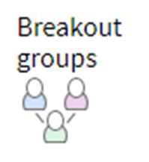
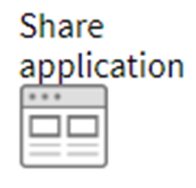
Blackboard Collaborate Ultra Tools
Tool | Purpose
 | You can start and run breakout groups encouraging your students to participate in group discussion or activities separate from the main room Students in the group can chat, share files, collaborate on the whiteboard and video call privately from the main group Great for: Brainstorming Problem solving Group work Note: Breakout group interactions aren't captured in recordings and content shared is not available when breakout groups end Content shown in the main room will not be displayed to the breakout groups
 | You or your students can share a blank whiteboard, an application, PDFs, PowerPoint presentations, and images in GIF, JPEG and PNG formats Great for: Sharing additional content Virtual ‘Gallery Walk’
 | You or your students can share your own desktop to showcase websites and links, animations, multimedia etc, applications and files including PDFs, PowerPoint presentations Great for: Sharing additional content Discussion case for Group activities Tip: when showcasing websites, links, multimedia content, open up tabs in your web browser before you start your virtual class

Slide 9
Teaching large scale classes in Blackboard Collaborate
Blackboard Collaborate has updated its features to include the ability to teach large cohort size classes for 250 – 500 students
Lecturers can now tick the 'Large Scale session (250+)' checkbox within the 'Session Settings' when creating/editing a session to enable large session mode however there are some limitations in order to help manage the increased number of attendees:
Session will be in a Webinar form
The session must not be longer than 24 hours
Ordinary Participants cannot use their microphone, camera or chat
Breakout groups cannot be used
Guest access URLs must be assigned the 'Participant' role

Slide 10
Tips to start your virtual active class
Start Small – think about what activities you would like to hold in your virtual class and plan. As your experience and confidence increases in teaching remotely you can incorporate more activities using a combination of different tools
Help your students understand the tools you are using to run these activities
Establish the etiquette of how students can ask questions or communicate during class and manage their
expectations as to how and when you will respond i.e. using ‘hand raise’ tool
Ensure your microphone and camera are working before the start of your virtual class
Ask your students to mute their microphones before the start of your virtual class
Consider drafting a ‘run sheet’ which outlines the order of the material you will teach and the activities
you will run
If recording your virtual classes, be sure to communicate this to your students at the beginning of each class
letting them know that any questions, comments, material shared will be captured

Slide 11
ETS Support
The ETS team are here to assist and support you at any time. You can:
Join a Teaching Remotely Webinar
Book a Virtual Consultation (One on One)
Book a Virtual Drop-In Session
Ask questions on the A.I.D.E Chatbot
Explore more digital resources on the Teaching Remotely Sharepoint site https://unsw.sharepoint.com/sites/teach-remotely
For more information please visit ‘ETS Contact Us’ on
https://unsw.sharepoint.com/sites/teach-remotely/SitePages/ETS-Support-for-Teaching-Remotely.aspx

Slide 12
Q & A Session

Slide 13
Active Learning
Tools
and
Resources

Slide 14
Active Learning Tools and Resources
A number of resources have been developed through the Active Learning Initiative to support those who are teaching with an active learning mindset or for those who are thinking about doing so. These include:
Active Learning Guide
Active Learning Reference and Research Resource (separate supplementary resource to the Active Learning Guide)
Video resources showcasing:
Members of the UNSW teaching community and their active learning classes
Examples of Classroom Activities (coming soon)
360 deg interactive tours of five active learning spaces (more currently in development)
Guide on using Lecture Recordings + as an Active Learning tool
Furniture Layout ideas for active learning spaces
Active Learning Framework for Large Cohort Sizes (coming soon)
Let’s Meet: Active Learning Information sessions (more to come)
Planning continues for more resources, for more information please visit
www.learningenvironments.unsw.edu.au/resources

Slide 15
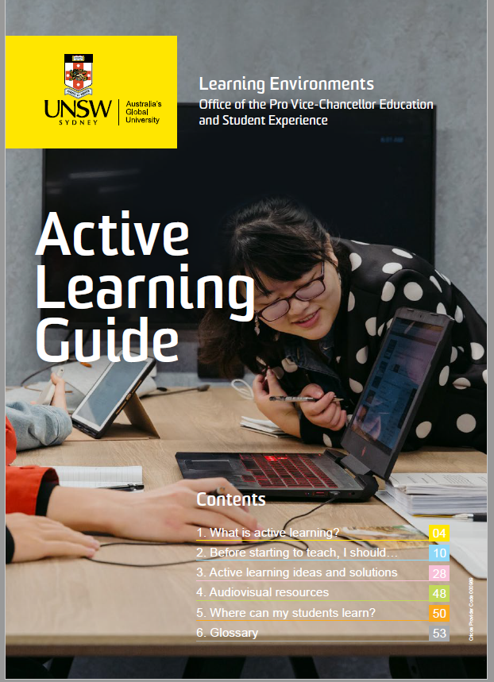
Active Learning Guide
Provides practical advice and guidance for those teaching or wishing to teach
an active learning course
5 Topics:
What is active learning?
Before starting to teach, I should….
Active learning ideas and solutions
Audiovisual resources
Where can my students learn?
The Active Learning Reference and Research Resource is a supplementary booklet
to the Active Learning Guide providing further references and resources
www.learningenvironments.unsw.edu.au/resources/active-learning
Physical copies will be available in Active Learning Spaces across the Kensington campus
Digital copies (containing interactive links) available on the Learning Environments website

Slide 16
Furniture Layouts for Active Learning Spaces
Provides suggestions on how flexible furniture in an active learning space can be set up in different layouts to
enhance student learning. These suggestions can help with the planning of classroom activities for your
students or let them inspire you to come up with layout ideas of your own.
Two sets of resources
Six 3D Posters suggested layouts that an be adapted or used in any flat floor teaching space with flexible furniture
‘Flexible Setup. Active Learning’ Posters depicting unique furniture layouts for individual CATS rooms have been placed in the following locations:
BioSciences Building G07
Mathews Building Levels 1,2 & 3
Science and Engineering Building Basement & Ground Level
Please visit https://www.learningenvironments.unsw.edu.au/resources/teaching to view the 3D Posters

Slide 17
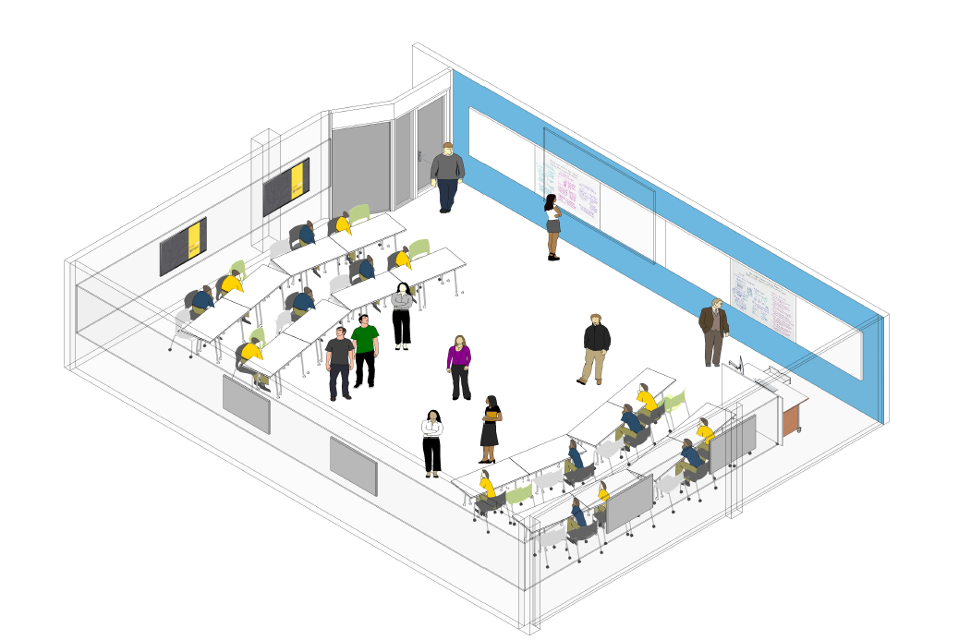
Furniture Layout: 3D Poster

Slide 18
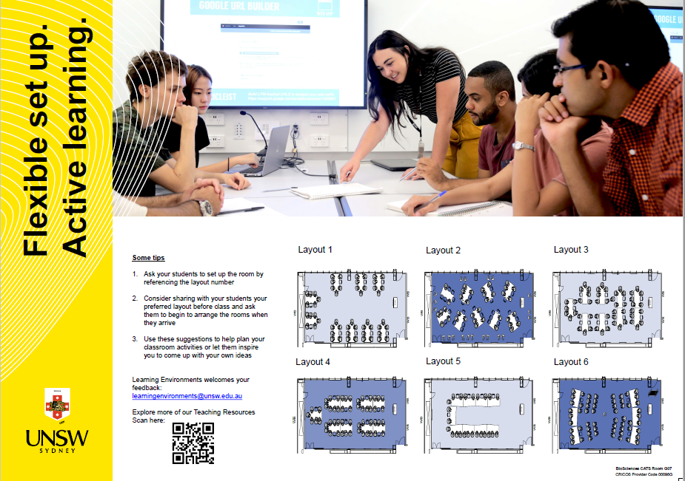
Furniture Layout: Flexible Setup. Active Learning Poster

Slide 19
Learning Environments Support
Learning Environments are here to assist and support you at any time. You can:
Email learningenvironments@unsw.com.au
Submit feedback form on www.learningenvironments.com.au/contact-us
Explore more about teaching spaces and resources on www.learningenvironments.com.au

Slide 20
Q & A Session

Slide 21
UNSW Active Learning Initiative:
Supporting Academic staff in Active
Learning Spaces
Image goes here
Thank you

