Slide 1

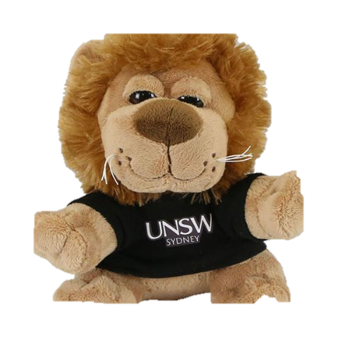















Live Stream – Lectures/Tutorials/Class Netiquette
Hello
Mute your microphone when not speaking
Say Hi when you arrive in the chat-box
Turn your webcam on when speaking
Use the raise hand button when you have a question or wish to talk
Use the chat-box feature to ask or answer a question
Be on
Time, be prepared!
Use earphones with a microphone to reduce background noise
Wear what you would for class.
Remove or silence distractions
Sit in a well-lit space and mindful of your background.
Remember some classes are being video recorded
Make room for everyone to have a chance to speak
Use the same professional language you would in a F2F class
Remember some classes are being video recorded
All students must adhere to UNSW’s Student Code
Be patient, be kind, be respectful

